Slide 1
Topic 07 Business Analytics
ICT394 BI Application
Development

Slide 2

Resources
Reading:
Stubbs (2013), Chapters 1 & 2
Case Study: Allrecipes

Slide 3
Learning Outcomes
At the completion of this topic, you should be able to:
Define and provide appropriate examples of business analytics
Explain, using examples, the differences between descriptive, predictive and prescriptive analytics
Provide examples of the use of different types of reports
Perform various analytics techniques on given data sets
Create a plan for a business analytics investigation
This topic contributes to the following unit learning outcomes:
1. Demonstrate an understanding of the role of BI in organisations
6. Present analyses of data using a number of different techniques

Slide 4
Lecture Outline
What is Business Analytics?
Types of Business Analytics
Types of Reports
SMART Goals
Developing a Business Analytics plan
Topic Summary

Slide 5
ICT394 Business Intelligence Application Development
Topic 07 Part 02:
What is Business Analytics?

Slide 6
Business Analytics
A broad term, defined differently by different authors
Stubbs (2013) provides such a definition:
“analytics can be considered any data-driven process that provides insight” (p.5)
Seddon et al (2016):
“the use of data to make sounder, more evidence-based business decisions”

Slide 7
How does BA provide insight?
Reporting
Trending
Segmentation
Predictive Modelling

Slide 8
Insight generation
Each of the broad types of analytics have the following in common:
They are based on data
They use mathematical techniques to transform and summarize the data
They add value
See Link - How Forecasting Works in Tableau or download the article vial LMS

Slide 9
Advanced Analytics
Focus is on
WHY things are happening
WHAT things are likely to happen
Requires more complex toolset
Operations research
Statistics
Multivariate analyses
Decision trees
Regressions

Slide 10
Business Outcomes
Business relevancy
Actionable insight
Performance measurement and value measurement

Slide 11
ICT394 Business Intelligence Application Development
Topic 07 Part 03:
Types of Business Analytics

Slide 12
Descriptive Analytics
AKA Reporting
What is happening and understanding the underlying trends and causes
Relies on consolidated data sources (e.g., BI target database/data warehouse)
Includes a high degree of visualisation
Some interesting case studies are listed in the readings for this topic – Seattle Children’s and Kaleida Health.

Slide 13
Predictive Analytics
Aims to determine what will happen in the future
Will generally be based on statistical techniques and other techniques that will often fall under the heading of data mining
Often used to predict churn, products likely to appeal, creditworthiness assessment
Moneyball!

Slide 14
Prescriptive Analytics
Goal is to recognise what is happening as well as the forecast and to be able to make decisions that will achieve the best possible performance
Generally aimed at optimisation of system performance
The types of recommendations provided by these types of systems may be yes/no or production of a recommended amount
They might also be used directly in automated rules-based decision systems such as airline pricing systems

Slide 15
ICT394 Business Intelligence Application Development
Topic 07 Part 04:
Types of Reports

Slide 16
What is a report?
Document that contains information relevant to the domain of interest
Used in management decision making
Will use data from a variety of sources
Iterative reporting cycle:
Data acquisition → Information Generation → Decision Making → Business Process Management → Data acquisition etc…

Slide 17
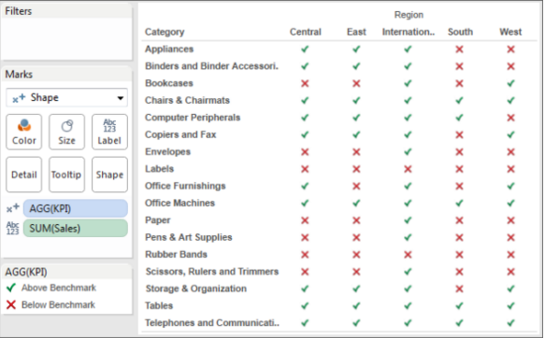
Metric Management Reports
Performance against desired outcome
Service level agreements
KPI’s
6-Sigma/Total Quality Management

Slide 18
Dashboards
A way of presenting a range of performance indicators on a single page
We will address these in more depth later in the course
…and, building them in the workshops and assignment

Slide 19
Balanced Scorecard (BSC)
The BSC is a system that measures success in an organisation, but looks beyond just the financial perspective
Customer perspective
Internal Business Process perspective
Learning and growth perspective

Slide 20
ICT394 Business Intelligence Application Development
Topic 07 Part 05:
SMART Goals

Slide 21

Business Analytics
So, BA is about developing or creating insight from data
But how?
In order to develop insight, we need to be sure that we understand what it is we are trying to do…
What problem are we trying to solve?
Watch this video now: https://www.coursera.org/learn/analytics-tableau/lecture/ruazC/rock-projects

Slide 22
Value
What is the value of the BA project to the organisation?
In order to understand this, we need to understand what problem it is the organisation is asking us to solve.
The best way to do this, is to ASK QUESTIONS…

Slide 23
Stakeholders
In order to make sure we are asking questions of the right people, we need to make sure we know who the right people are!
By doing this, and asking appropriate questions, we will be in the best position to be able to work constructively with the client to solve their problem
A good place to start might be:
“What problem is it that you hope to solve by developing this project?”

Slide 24
Questions…
…and ask more and more and more ☺
“How is this problem affecting the organisation?”
“What is your ideal outcome of the project?”
The purpose of asking these questions is to make sure that you really do understand what the stakeholders’ needs are
See (revised link): https://www.modernanalyst.com/Resources/Articles/tabid/115/ID/179/8-Questions-EveryBusiness-Analyst-Should-Ask.aspx

Slide 25
SMART
Specific
Greater chance of accomplishing a specific goal than a general goal
Measureable
Need to be able to understand if we are making progress (or not) toward our goal
Attainable
No point in setting a goal that cannot be attained regardless of how much effort you put in
Relevant
You need to be willing AND able to achieve the goal
Time-bound
Achievable within a given timeframe

Slide 26
How SMART?
Identify the business metric that needs to change in order to achieve the SMART goal
How should it change, and by how much?
If we can answer this, then our goals are more likely to be SPECIFIC and MEASUREABLE

Slide 27
Dependent and Independent Variables
Dependent variable is the business metric that we need to change
Independent variable is what we use to change the dependent variable

Slide 28
Example
Our problem is that too many people are not returning to our site after they log in for the first time…
How to convert first time visitors to returning visitors?
A vague project goal would be:
Increase the number of returning visitors to the website.
Is it SMART?

Slide 29
SMART
Better would be:
Increase the number of returning visitors on a month-by-month basis by 15% compared to the same month last year
What do you think the DV is for this goal?
Ask yourself, what is it we are trying to change, and
What data will you need in your dataset to be able to show the DV?

Slide 30
Relevant?
R:
We need to ensure that we are solving the correct problem. In this case, the number of visitors might not be the real problem, the real problem might be a drop in revenue…
IF that is the case, then a better project goal might be:
Determine the website changes that will most efficiently increase revenues by 15% on a month-by-month bases compared to the same month last year

Slide 31
Time-bound?
The goal of the project is to, within 2 months, determine the website changes that will most efficiently increase revenues by 15% on a month-by-month bases compared to the same month last year
What’s left? A…

Slide 32
Attainable?
The client might simply not collect the data you will need to identify the changes that are needed to be made to the website…
If this was the case, then it would be impossible to achieve the goal in the time stated
Might need to start a project on redesigning how data is captured by the web site
This might take much longer than you have!

Slide 33
Updated goals:
If the organisation does collect good data from its website:
In 2 months, analyze archived click-stream data to determine the website changes that will most efficiently increase revenues by 15% on a month-by-month basis compared to the same month last year
If not…
In 3 months, install a system that will collect and store click-stream data in a cloud-based relational database. By 2 months after the system is installed...
Much SMARTer than our original goal...
Increase the number of returning visitors to the site...

Slide 34
…and then what?
These goals need to be discussed and possibly refined in consultation with the stakeholders
Everyone needs to be playing the same tune!
Asking lots of questions will help to determine what the independent variables might be…

Slide 35
ICT394 Business Intelligence Application Development
Topic 07 Part 06:
Developing a Business Analytics Plan

Slide 36
Planning…
As with most things, a lack of planning will make progress more difficult
BA is no different
Planning helps us to know:
What we know
What we don’t know
What we need to know

Slide 37
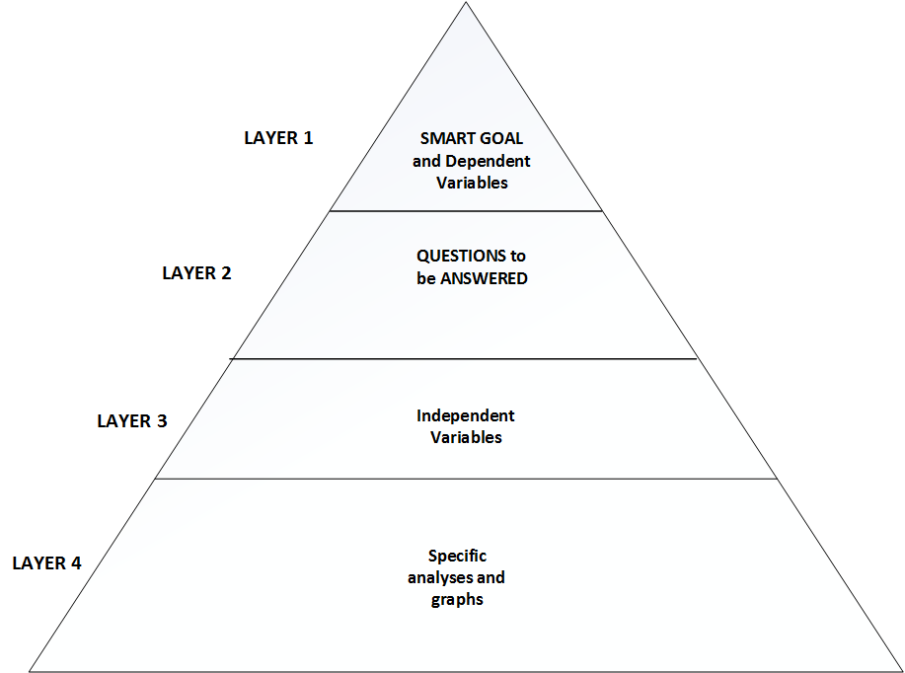

Slide 38
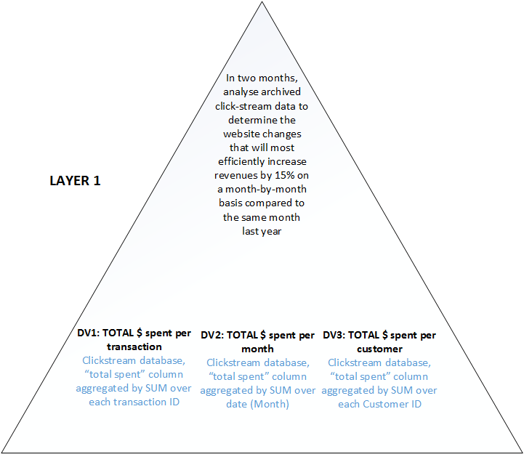

Slide 39
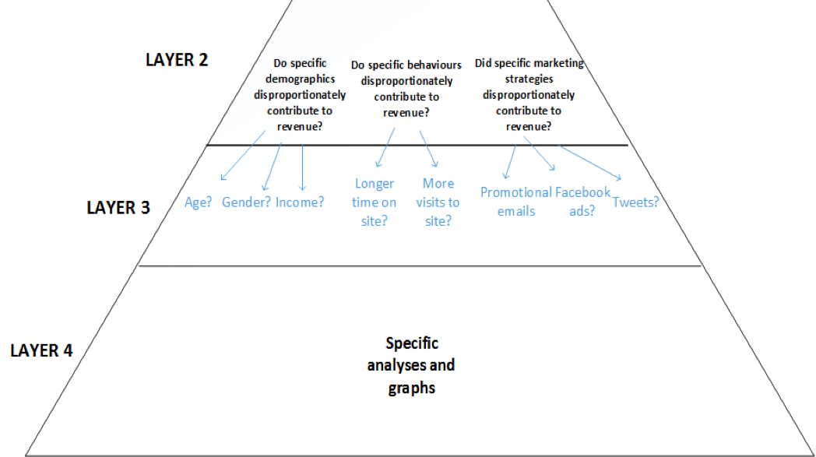

Slide 40
ICT394 Business Intelligence Application Development
Topic 07 Part 07:
Topic Summary

Slide 41
Learning Outcomes
At the completion of this topic, you should be able to:
Define and provide appropriate examples of business analytics
Explain, using examples, the differences between descriptive, predictive and prescriptive analytics
Provide examples of the use of different types of reports
Perform various analytics techniques on given data sets
Create a plan for a business analytics investigation
This topic contributes to the following unit learning outcomes:
1. Demonstrate an understanding of the role of BI in organisations
6. Present analyses of data using different techniques

Slide 42
Lecture Outline
What is Business Analytics?
Types of Business Analytics
Types of Reports
SMART Goals
Developing a Business Analytics plan
Topic Summary

Slide 43
Where to from here…
The next topic deals with Data Mining
Following that, we will move into the Presentation section of the unit which will discuss visualisation in more detail

